Slide 1
Implications of a ditributed environment
Part Two

Slide 2
Distributed query processing and optimization
New challenges
Data transmission costs (network)
parallelism
Choice of replicas: lowest transmission cost
Fragmentation: to reconstruct the original relation
Query decomposition: query rewriting/unfolding
depending on how data is fragmented/replicated
query
answer
decomposition
global schema
local schema
local schema
local schema
sub-query
sub-query
sub-query
DBMS
network
DBMS
network
DBMS
DB
DB
DB

Slide 3
Query optimization:
Process of producing an optimal (close to optimal) query execution plan which represents an execution strategy for the query
– The main task in query optimization is to consider different orderings of the operations
• Centralized query optimization:
– Find (the best) query execution plan in the space of equivalent query trees
– Minimize an objective cost function
– Gather statistics about relations
• Distributed query optimization brings additional issues
– What and where to ship the relations
– How to ship relations (ship as a whole, ship as needed)
– When to use semi-joins instead of joins

Slide 4
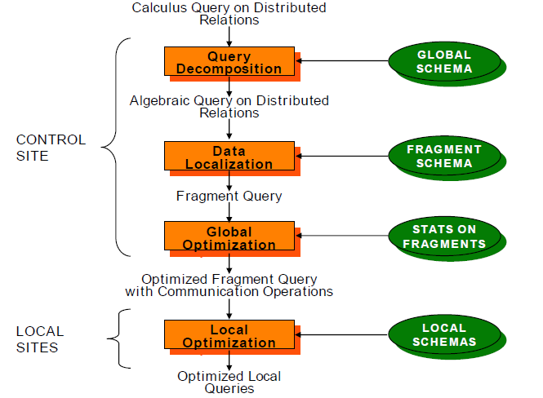
Basic Concepts

Slide 5
Query Optimization
In a query involving a multi-site join and, possibly, a distributed database with replicated files, the distributed DBMS must decide where to access the data and how to proceed with the join. Three step process:
Query decomposition - rewritten and simplified
Data localization - query fragmented so that fragments reference data at only one site
Global optimization -
Order in which to execute query fragments
Data movement between sites
Where parts of the query will be executed

Slide 6
Distributed Query Optimization
Cost-based approach; consider all plans, pick cheapest; similar to centralized opt.
Difference 1: Consider communication costs Difference 2: Respect local site autonomy Difference 3: New distributed join methods.
Query site constructs global plan, with suggested local plans describing processing at each site.
If a site can improve suggested local plan, free to do so.

Slide 7
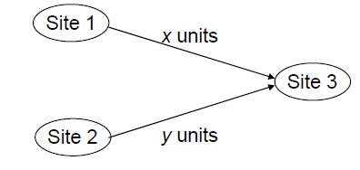
Data Shipping

Slide 8
Data shipping
When one relationships transmitted to other sites, not all the data participate in the join-operation or could be used.
So, the data which don’t participate in the join-operation or useless will not be in the network transmission. The basic principle of query optimization strategy based on semi-join operation just reduces the data quantity in relationship operation and the data transmission among sites.

Slide 9
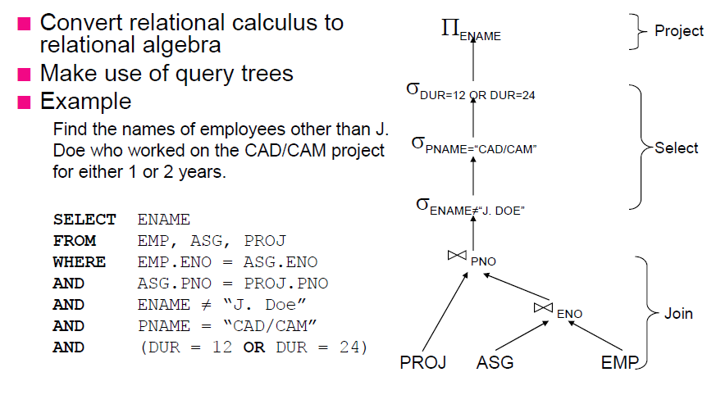
Restructure Queries

Slide 10
Data Localization
Input: Algebraic query on distributed relations
Determine which fragments are involved
Localization program
substitute for each global query its materialization program
optimize

Slide 11
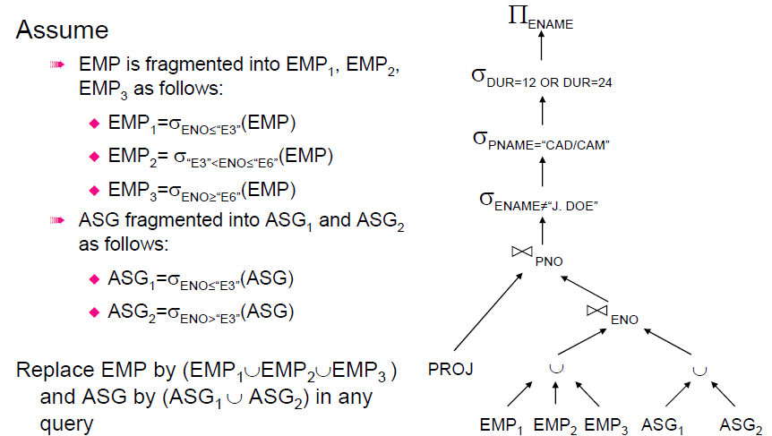
Example

Slide 12
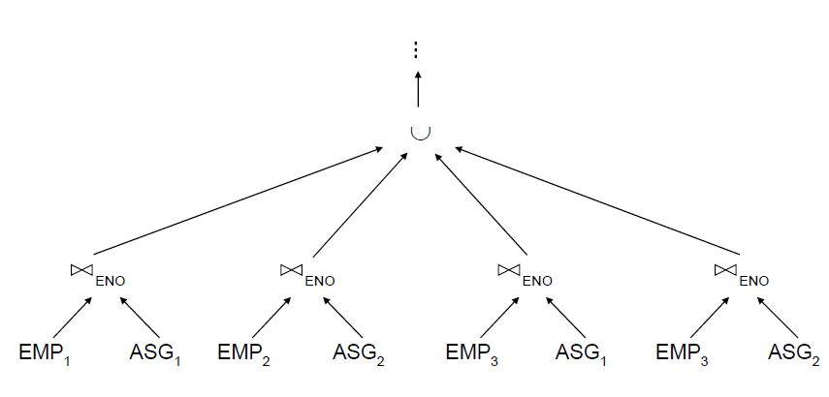
Provides Parallelism

Slide 13
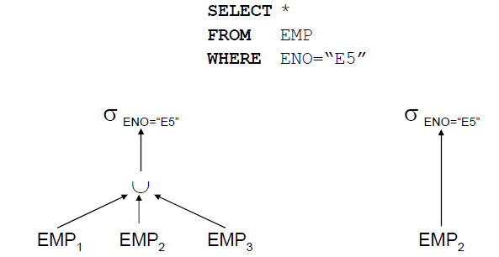
Reduction with Selection

Slide 14
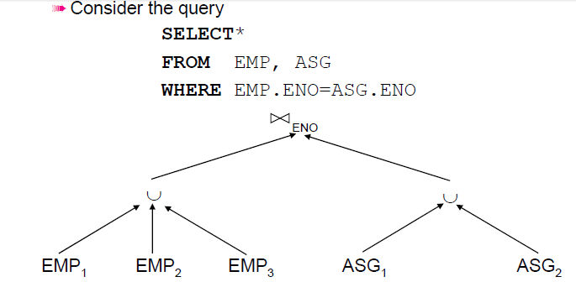
Reduction with Join

Slide 15
Global Query Optimization
Input: Fragment query
􀁑 Find the best (not necessarily optimal) global
schedule
􀂯 Minimize a cost function
􀂯 Distributed join processing
􀁘 Bushy vs. linear trees
􀁘 Which relation to ship where?
􀁘 Ship-whole vs ship-as-needed
􀂯 Decide on the use of semijoins
􀁘 Semijoin saves on communication at the expense of
more local processing.
􀂯 Join methods
􀁘 nested loop vs ordered joins (merge join or hash join)

Slide 16
Cost Based Optimization
Solution space
􀂯 The set of equivalent algebra expressions (query trees).
􀁑 Cost function (in terms of time)
􀂯 I/O cost + CPU cost + communication cost
􀂯 These might have different weights in different distributed
environments (LAN vs WAN).
􀂯 Can also maximize throughput
􀁑 Search algorithm
􀂯 How do we move inside the solution space?
􀂯 Exhaustive search, heuristic algorithms (iterative
improvement, simulated annealing, genetic,…)

Slide 17
Cost Functions
Total Time (or Total Cost)
􀂯 Reduce each cost (in terms of time) component individually
􀂯 Do as little of each cost component as possible
􀂯 Optimizes the utilization of the resources
Increases system throughput
􀁑 Response Time
􀂯 Do as many things as possible in parallel
􀂯 May increase total time because of increased total activity

Slide 18
Query Processing in Distributed Databases: Semi-join
Idea: Tradeoff cost of computing and shipping projection for cost of shipping full relation.
Note: Especially useful if there is selection on full relation (that can be exploited via index); and answer desired back at initial site.
where R and S are relations.The result of this semijoin is the set of all tuples in R for which there is a tuple in S that is equal on their common attribute names.

Slide 19
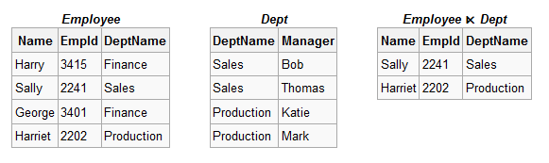
Semi join
Example: consider the tables Employee and Dept and their semi join:

Slide 20
Query Processing in Distributed Databases: Semi-join
Semijoins can be used to efficiently implement joins
– The semijoin acts as a size reducer (similar as to a selection) such that smaller relations need to be transferred
• Consider two relations: R located at site 1 and S located and site 2
– Solution with semijoins: Replace one or both operand relations/fragments by a semijoin, using the following rules:
R ⋊⋉A S () (R ⊲<A S) ⋊⋉A S
() R ⋊⋉A (S ⊲<A R)
() (R ⊲<A S) ⋊⋉A (S ⊲<A R)
• The semijoin is beneficial if the cost to produce and send it to the other site is less than
the cost of sending the whole operand relation and of doing the actual join.

Slide 21
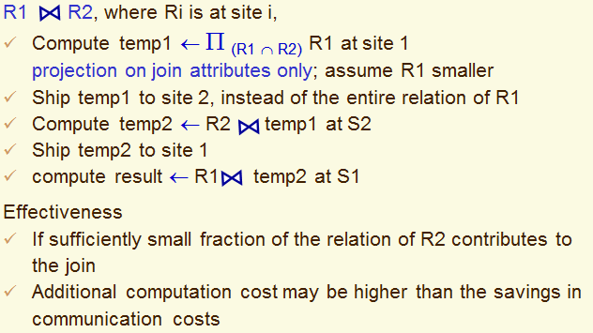
Query Processing in Distributed Databases: Semijoin

Slide 22
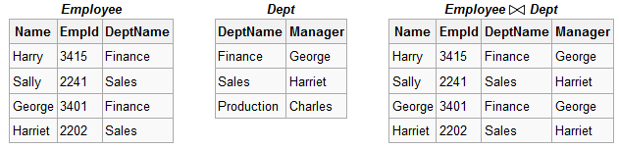
Join Operation
The result of the join is the set of all combinations of tuples in R and S that are equal on their common attribute names.
Example: consider the tables Employee and Dept and their natural join:

Slide 23
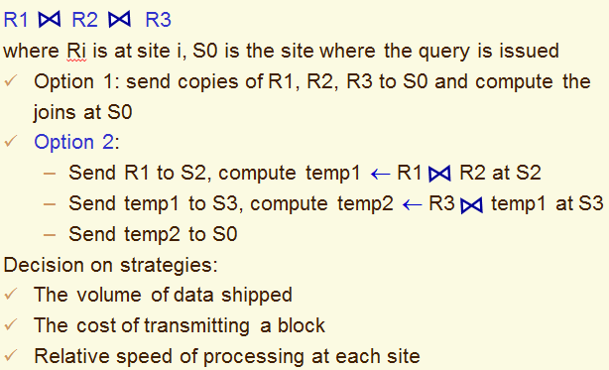
Query Processing in Distributed Databases: Join Operation

Slide 24
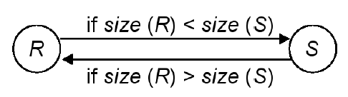
Join fragment in ordering queries
Direct join odering of two relation/fragments located at different sites
– Move the smaller relation to the other site
– We have to estimate the size of R and S

Slide 25
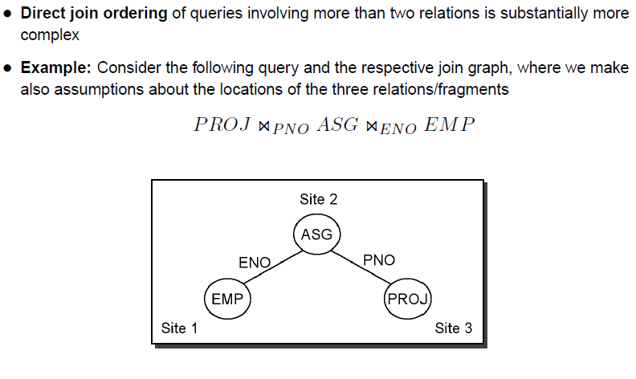
Join Fragment in fragment queries

Slide 26
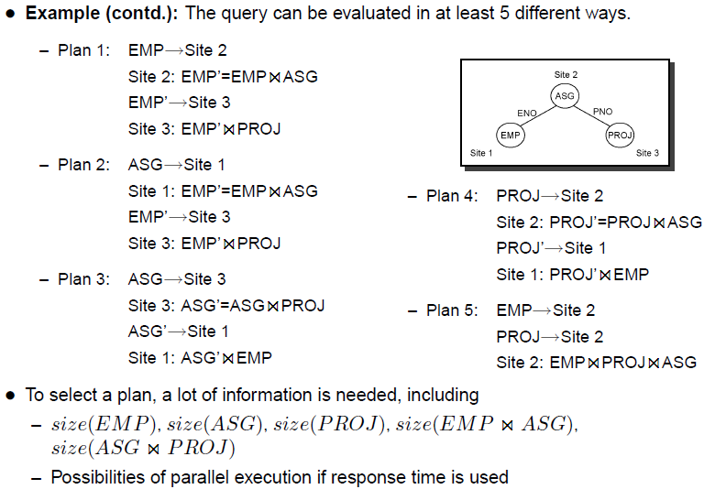
Join Fragment in fragment queries

Slide 27
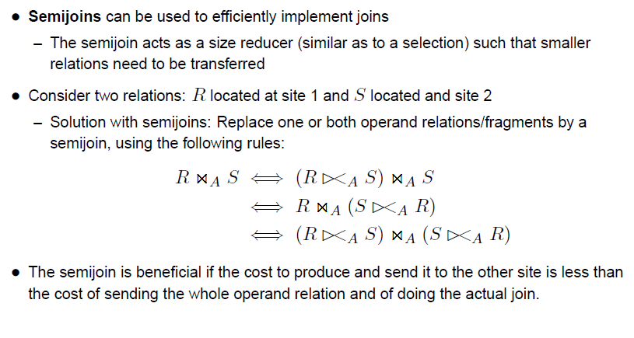
Semi-join based algorithms

Slide 28
Distributed query optimization
The volume of data shipped
The cost of transmitting a block
Relative speed of processing at each site
Site selection: replication
Two-step optimization
At compile time, generate a query plan – along the same lines as centralized DBMS
Every time before the query is executed, transform the plan and carry out site selection (determine where the operators are to be executed) – dynamic, just site selection

Slide 29
Query Optimization
In a query involving a multi-site join and, possibly, a distributed database with replicated files, the distributed DBMS must decide where to access the data and how to proceed with the join. Three step process:
Query decomposition - rewritten and simplified
Data localization - query fragmented so that fragments reference data at only one site
Global optimization -
Order in which to execute query fragments
Data movement between sites
Where parts of the query will be executed

Slide 30
Example
Example relations: Employee at site 1 and Department at Site 2
Employee at site 1. 10,000 rows. Row size = 100 bytes. Table size = 10⁶ bytes.
Department at Site 2. 100 rows. Row size = 35 bytes. Table size = 3,500 bytes.
Q: For each employee, retrieve employee name and department name Where the employee works.
Q: Π_{Fname,Lname,Dname} (Employee _{no = Dnumber} Department)
Fname | Minit | Lname | SSN | Bdate | Address | Sex | Salary | Superssn | Dno
Dname | Dnumber | Mgrssn | Mgrstartdate

Slide 31
Example(contd…)
Result
The result of this query will have 10,000 tuples, assuming that every employee is related to a department.
Suppose each result tuple is 40 bytes long. The query is submitted at site 3 and the result is sent to this site.
Problem: Employee and Department relations are not present at site 3.

Slide 32
Example(contd…)
Strategies:
Transfer Employee and Department to site 3.
Total transfer bytes = 1,000,000 + 3500 = 1,003,500 bytes.
Transfer Employee to site 2, execute join at site 2 and send the result to site 3.
Query result size = 40 * 10,000 = 400,000 bytes. Total transfer size = 400,000 + 1,000,000 = 1,400,000 bytes.
Transfer Department relation to site 1, execute the join at site 1, and send the result to site 3.
Total bytes transferred = 400,000 + 3500 = 403,500 bytes.
Optimization criteria: minimizing data transfer.

Slide 33
Example(contd…)
Strategies:
Transfer Employee and Department to site 3.
Total transfer bytes = 1,000,000 + 3500 = 1,003,500 bytes.
Transfer Employee to site 2, execute join at site 2 and send the result to site 3.
Query result size = 40 * 10,000 = 400,000 bytes. Total transfer size = 400,000 + 1,000,000 = 1,400,000 bytes.
Transfer Department relation to site 1, execute the join at site 1, and send the result to site 3.
Total bytes transferred = 400,000 + 3500 = 403,500 bytes.
Optimization criteria: minimizing data transfer.
Preferred approach: strategy 3.

Slide 34
Example(contd…)
Consider the query
Q’: For each department, retrieve the department name and the name of the department manager
Relational Algebra expression:
Π_{Fname,Lname,Dname} (Employee _{Mgrssn = SSN} Department)

Slide 35
Example(contd…)
The result of this query will have 100 tuples, assuming that every department has a manager, the execution strategies are:
Transfer Employee and Department to the result site and perform the join at site 3.
Total bytes transferred = 1,000,000 + 3500 = 1,003,500 bytes.
Transfer Employee to site 2, execute join at site 2 and send the result to site 3. Query result size = 40 * 100 = 4000 bytes.
Total transfer size = 4000 + 1,000,000 = 1,004,000 bytes.
Transfer Department relation to site 1, execute join at site 1 and send the result to site 3.
Total transfer size = 4000 + 3500 = 7500 bytes.

Slide 36
Example(contd…)
The result of this query will have 100 tuples, assuming that every department has a manager, the execution strategies are:
Transfer Employee and Department to the result site and perform the join at site 3.
Total bytes transferred = 1,000,000 + 3500 = 1,003,500 bytes.
Transfer Employee to site 2, execute join at site 2 and send the result to site 3. Query result size = 40 * 100 = 4000 bytes.
Total transfer size = 4000 + 1,000,000 = 1,004,000 bytes.
Transfer Department relation to site 1, execute join at site 1 and send the result to site 3.
Total transfer size = 4000 + 3500 = 7500 bytes.
Preferred strategy: Choose strategy 3.

Slide 37
Example(contd…)
Now suppose the result site is 2. Possible strategies :
Transfer Employee relation to site 2, execute the query and present the result to the user at site 2.
Total transfer size = 1,000,000 bytes for both queries Q and Q’.
Transfer Department relation to site 1, execute join at site 1 and send the result back to site 2.
Total transfer size for Q = 400,000 + 3500 = 403,500 bytes and for Q’ = 4000 + 3500 = 7500 bytes.

Slide 38
Example(contd…)
Semijoin:
Objective is to reduce the number of tuples in a relation before transferring it to another site.
Example execution of Q or Q’:
Project the join attributes of Department at site 2, and transfer them to site 1. For Q, 4 * 100 = 400 bytes are transferred and for Q’, 9 * 100 = 900 bytes are transferred.
Join the transferred file with the Employee relation at site 1, and transfer the required attributes from the resulting file to site 2. For Q, 34 * 10,000 = 340,000 bytes are transferred and for Q’, 39 * 100 = 3900 bytes are transferred.
Execute the query by joining the transferred file with Department and present the result to the user at site 2.

